Slide 1

www.sadhvisoft.com
INTERNSHIP PROJECT
REPORT
TITLE :HR-Employee-Attrition
NAME :Rishad A
BATCH :01
©2023 Sadhvisoft Copyright

Slide 2

Table of Contents
01
02
03
04
About Project
Details of Data
Tools Used
Main KPI’s
05
06
07
Screenshots
My Design
Conclusion
www.sadhvisoft.com

Slide 3
ABOUT PROJECT
Employee attrition can quietly harm even the most successful organizations in a surprisingly short time. While many companies focus on the expensive process of hiring, not enough attention is given to solving the reasons top talent leaves.
Although people often think that low pay is the main reason for employees leaving, Understanding why employees leave is the first step in fixing the problem before it seriously damages your organization.
This analysis aims to give employers practical insights to understand their employees better and make necessary changes before turnover rates rise, productivity falls, and the company's future becomes uncertain.
www.sadhvisoft.com

Slide 4
DETAILS OF DATA
EDA projects will be performing for HR-Employee-Attrition Analysis and interesting data set to work on. Explore the main reason for leaving and Understanding why employees leave is the first step in fixing the problem before it seriously damages your organization. This analysis result make as to clear the problem from the employees.
www.sadhvisoft.com

Slide 5
TOOLS USED
Pandas
Matplotlib
Seaborn
TableaU
www.sadhvisoft.com

Slide 6
MAIN KPI”s
Tasks
In This Project We Use To Handle How Attrition Cause Effect Based On Age, Monthly Income,Department,
1)How attrition affect by gender?
2)find out which department cause more attrition?
3)Does attrition impact work of department?
4)Is income is the main factor towards attrition?
5)what is the effect of age on attrition?
www.sadhvisoft.com

Slide 7
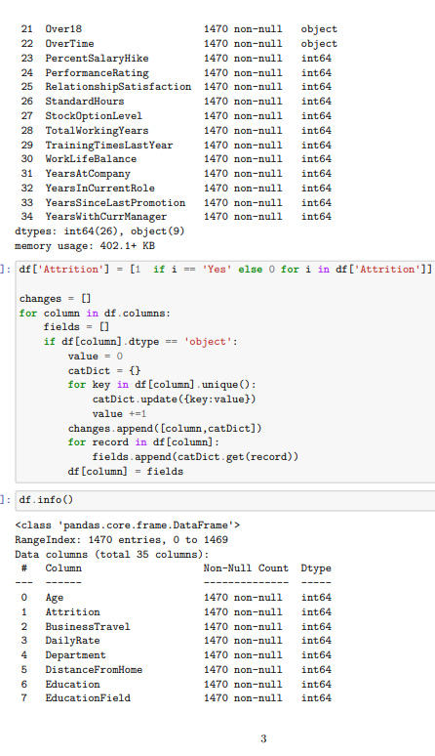
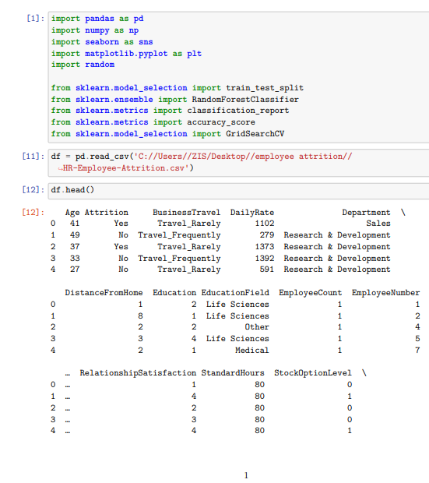
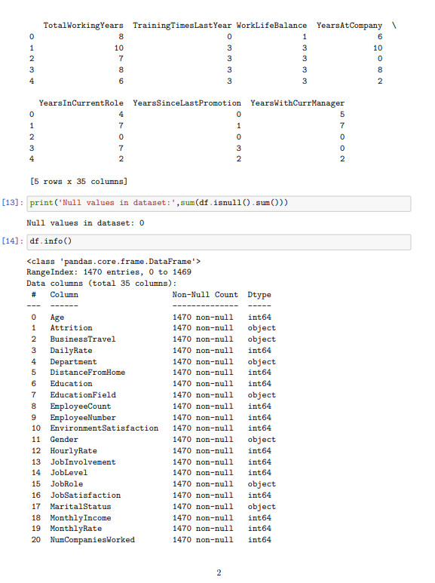
SCREENSHOTS
Python Code Screenshots
www.sadhvisoft.com

Slide 8
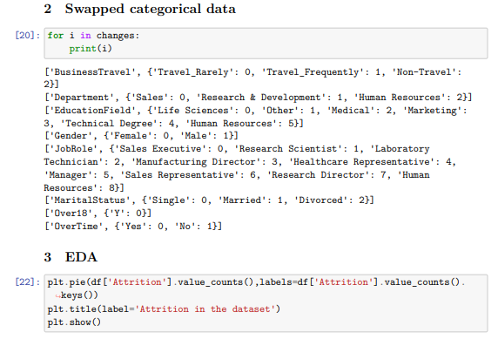
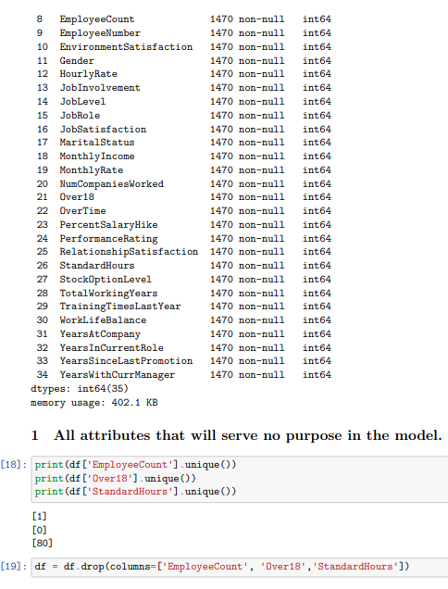
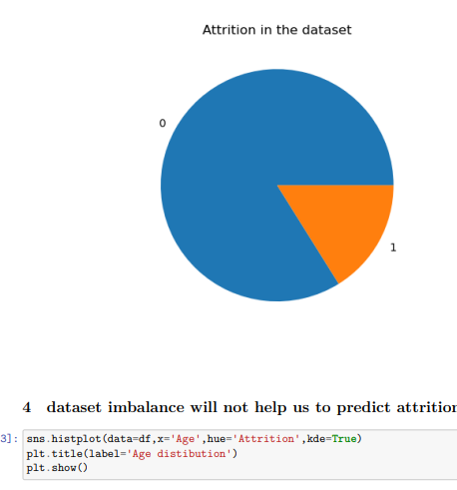
SCREENSHOTS
Python Code Screenshots
www.sadhvisoft.com

Slide 9
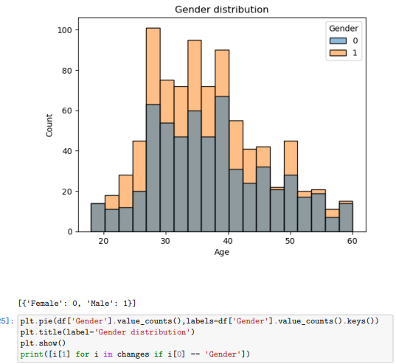
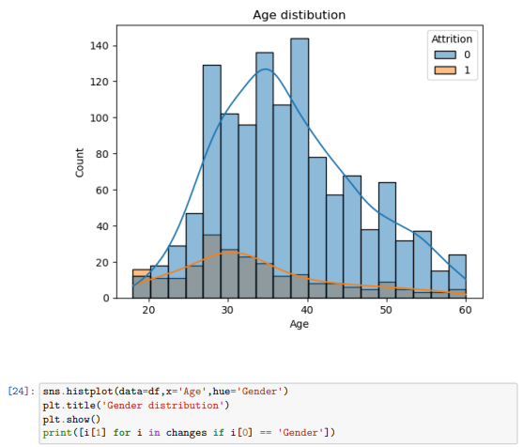
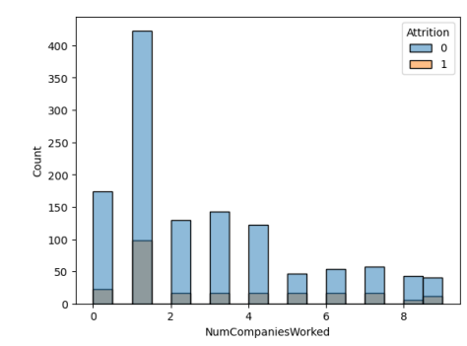
SCREENSHOTS
Python Code Screenshots
www.sadhvisoft.com

Slide 10
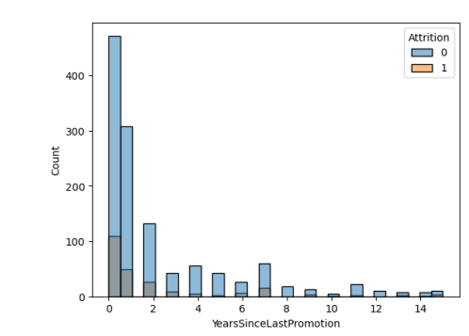
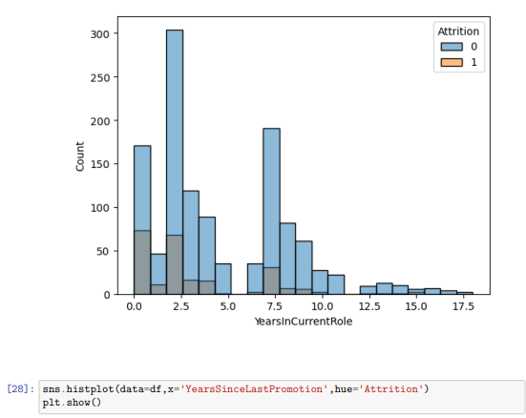
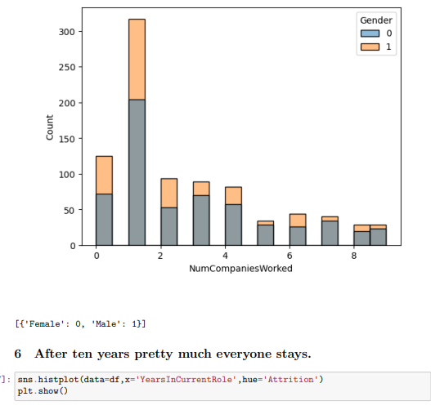
SCREENSHOTS
Python Code Screenshots
www.sadhvisoft.com

Slide 11
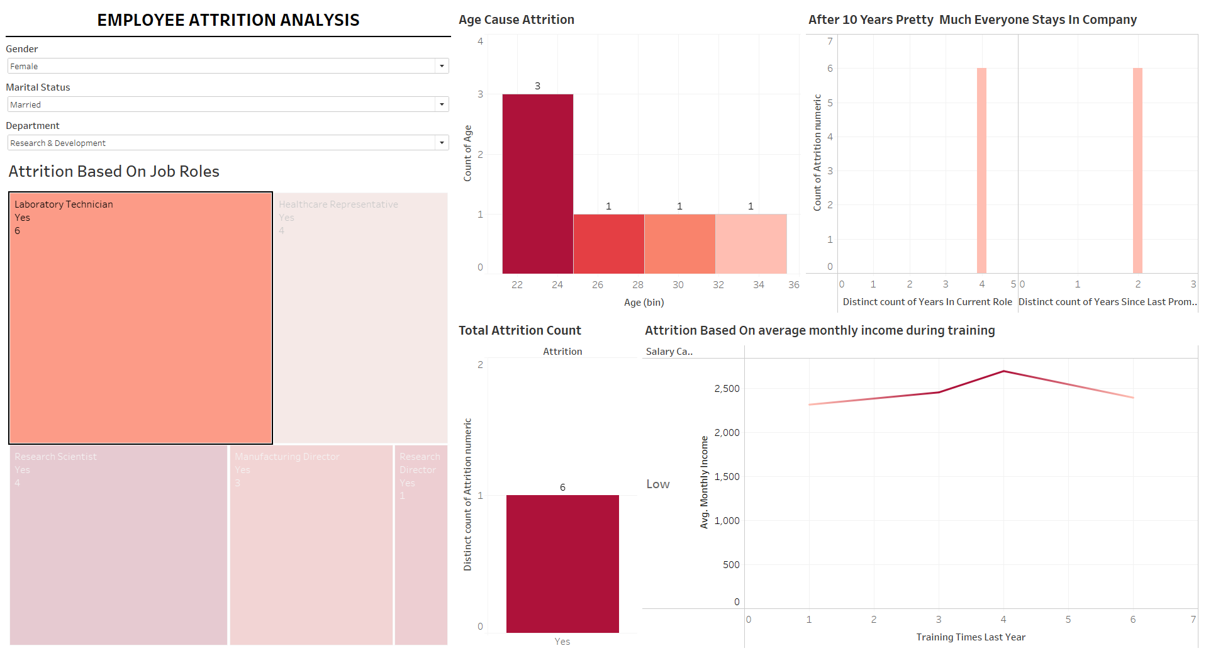
MY DESIGN
Tableau Report screenshot
www.sadhvisoft.com

Slide 12
CONCLUSION
After analyzing the factors contributing to attrition within the company, I have come up with several recommendations to help reduce attrition:
Improve employee engagement: Implement strategies to enhance employee engagement, such as regular feedback sessions, recognition programs, and opportunities for professional growth. Engaged employees are more likely to stay with the company.
Enhance work-life balance: Promote a healthy work-life balance by offering flexible work arrangements, encouraging employees to take breaks, and providing support for personal commitments. This can help reduce burnout and increase job satisfaction.
Offer competitive compensation and benefits: Conduct a thorough review of the company's compensation and benefits packages to ensure they are competitive within the industry. Providing fair and attractive rewards can help retain talented employees.
Provide opportunities for skill development: Invest in training and development programs to help employees enhance their skills and advance their careers within the company. This can increase job satisfaction and loyalty.
Conduct exit interviews: When employees do leave the company, conduct exit interviews to gather feedback on their reasons for leaving. This information can help identify patterns and areas for improvement.
www.sadhvisoft.com

Slide 13
www.sadhvisoft.com
Thank You!
©2023 Sadhvisoft Copyright
www.sadhvisoft.com

